Slide 1
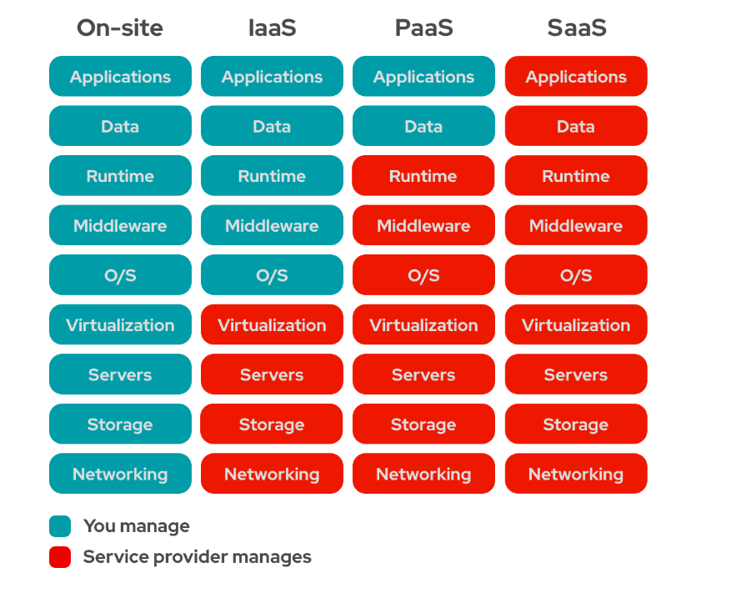
CLOUD COMPUTING (AWS)
In Easy terms, cloud computing means storing and accessing the data and programs on remote servers that are hosted on the internet instead of the computer’s hard drive or local server.
Cloud computing is also referred to as Internet-based computing.
Cloud Service models:
1.IAAS(Infrastructure As A Service)
2.SAAS(software As A Service)
3.PAAS(Platform As A Service)

Slide 2
1.IAAS (Infrastructure As A Service):
Infrastructure As A Service (IAAS) is means of delivering computing infrastructure as on-demand services.
It is one of the three fundamental cloud service models. The user purchases servers, software data center space, or network equipment and rent those resources through a fully outsourced, on-demand service model.
It allows dynamic scaling, and the resources are distributed as a service. It generally includes multiple-user on a single piece of hardware.
It totally depends upon the customer to choose its resources wisely and as per need. Also, it provides billing management too
2. PAAS (Platform As A Service) :
PAAS is a cloud delivery model for applications composed of services managed by a third party.
It provides elastic scaling of your application which allows developers to build applications and services over the internet and the deployment models include public, private and hybrid.
Basically, it is a service where a third-party provider provides both software and hardware tools to the cloud computing.
The tools which are provided are used by developers. PAAS is also known as Application PAAS. It helps us to organize and maintain useful applications and services.
It has a well-equipped management system and is less expensive compared to IAAS.

Slide 3
3. SAAS: (Software As A Service):
SAAS allows users to run existing online applications, and it is a model software that is deployed as a hosting service and is accessed over Output Rephrased/Re-written Text the internet or software delivery model during which software
its associated data are hosted centrally and accessed using their client, usually an online browser over the web. SAAS services are used for the development and deployment of modern applications.
It allows software and its functions to be accessed from anywhere with good internet connection device and a browser. An application is hosted centrally and also provides access to multiple users across various locations via the internet.
Creating AWS Free Tier Account:
The AWS Free Tier is automatically activated on each new AWS account.
With the AWS Free Tier, you can try out some AWS services free of charge up to a specific maximum amount of usage each month.
The free tier applies to certain participating AWS services2. The free-tier offerings last for 1 full year of opening your AWS account.
Please use below Link to Create AWS Free tier Account.
AWS Management Console (amazon.com)

Slide 4
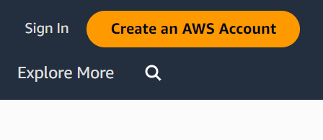
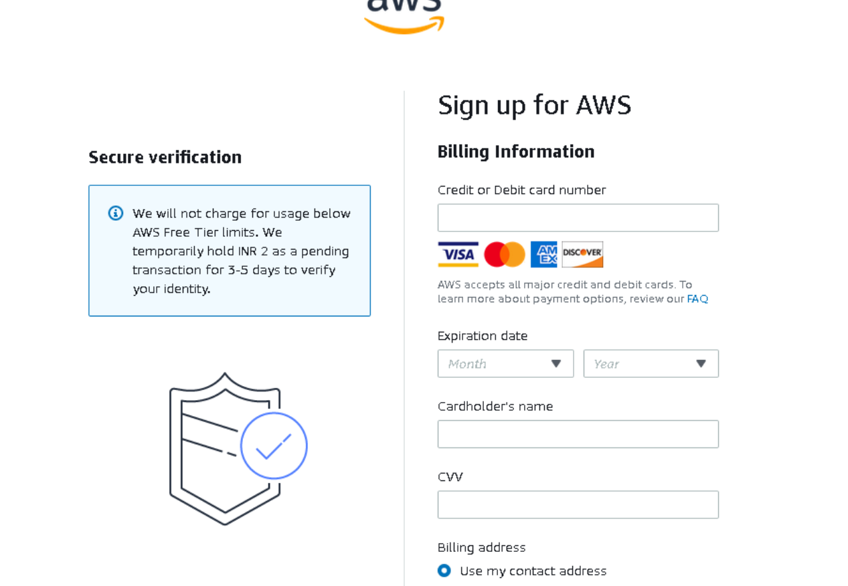
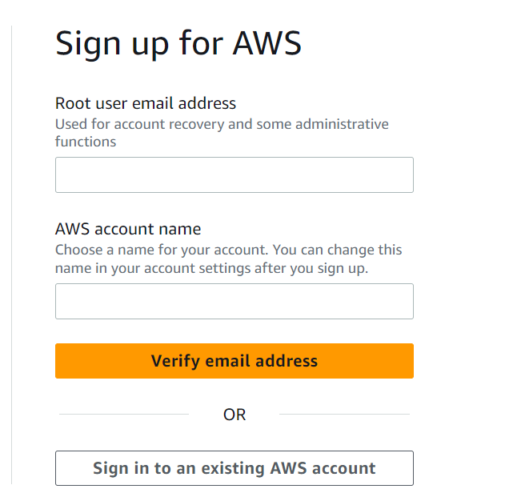
Look on below image and click on create an AWS account.
provide the details as required on below images.

Slide 5
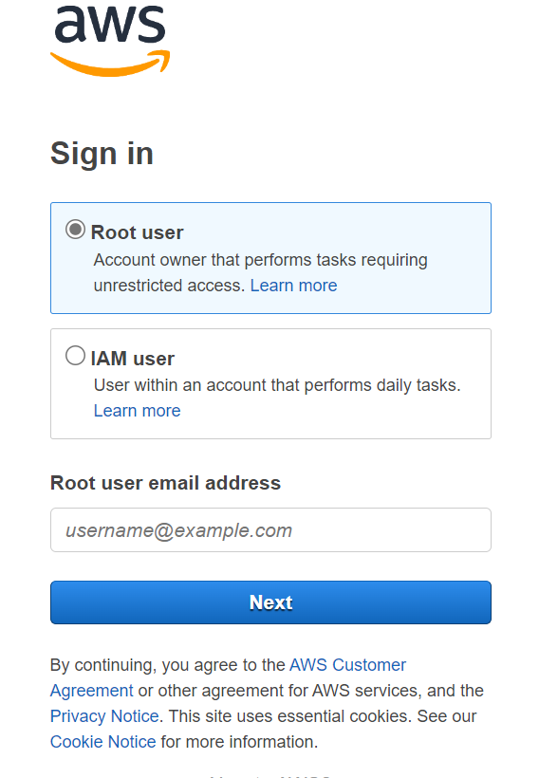
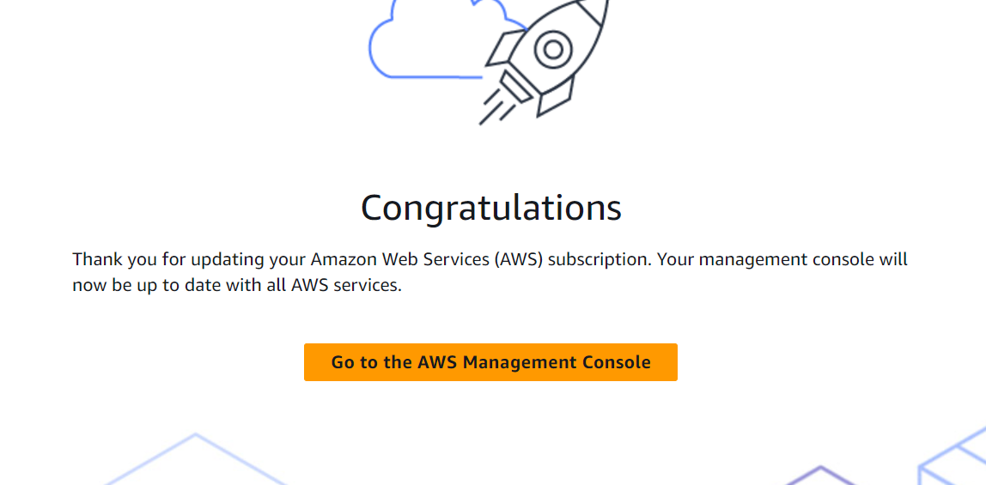
After creating AWS account, please sign in With credentials as Root user and once we logged in it will display second Image as shown below. (Right)

Slide 6
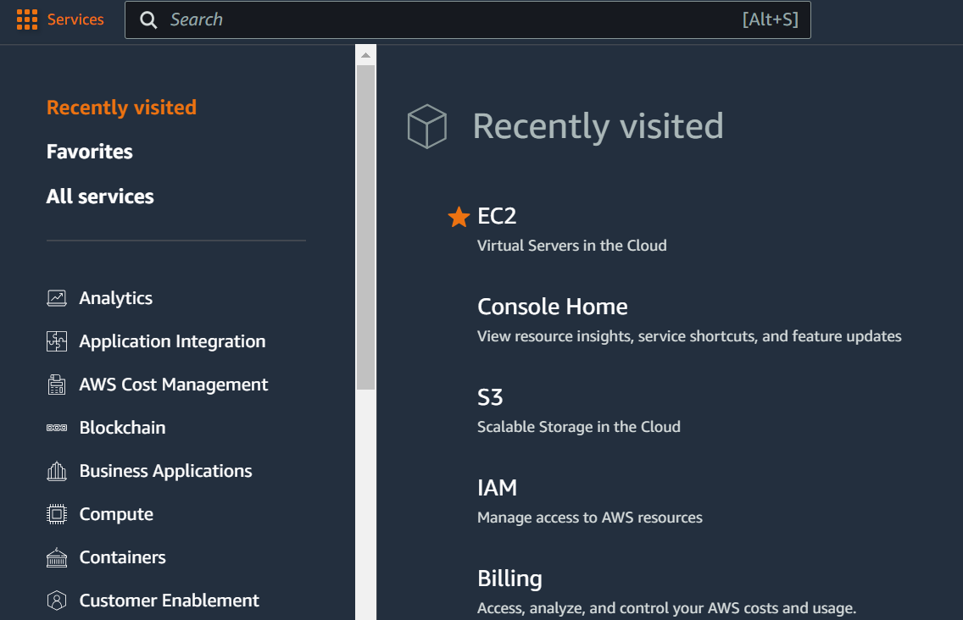
Once we logged in to AWS console, We can see the AWS services on Left Top and by using search box we can search for specific service.

Slide 7
EC2-Elastic compute cloud:
AWS EC2 (Elastic Cloud Compute) is a web service offered by Amazon that provides resizable compute capacity in the AWS cloud.
It offers Infrastructure as a service (IaaS). It provides complete control of computing resources, which one can scale as per the requirement.
Amazon Elastic Compute Cloud (Amazon EC2) offers the broadest and deepest compute platform, with over 600 instances .
choice of the latest processor, storage, networking, operating system, and purchase model to help you best match the needs of your workload.
750 hours free per month for (t2 micro) Instances.
INSTANCE:
A virtual server used for running applications on Amazon’s EC2 is an instance. An instance can be understood as a small part of a large computer, having its own hard drive, network connection, OS, etc.
You can have multiple small computers on a single physical machine, and all these small machines are called Instances.
INSTANCE TYPES:
1.On-Demand Instances
2. Reserved Instances (RI)12 months with the

Slide 8
3. Spot instances
1.On-Demand Instances:
There are no long-term commitments in case of On-Demand Instances.
They charge you for the compute capacity used per hour. Companies can increase or decrease the capacity depending on the demand of their application and will only pay for the specified hourly rate of the instance they choose.
The benefit of using On-Demand instance is that it saves you from the cost of managing, planning, and purchasing hardware and converts your large fixed costs into smaller variable costs. It also eliminates the need for “safety net” capacity to handle sudden traffic spikes.
2.Reserved Instances:
In Reserved Instances, there is a flexibility to change operating system types and tenancies.
RI has an optional capacity reservation for EC2 instances. AWS Billing applies discounted rates of RIs when the attributes of EC2 instance’s usage matches with that of an active RI.
EC2 reserves capacity matching the attributes of RI, if an Availability Zone (AZ) is specified. The running instances automatically utilize the capacity reservation of RI which matches its attributes.

Slide 9
RESERVED INSTANCES IS ALSO SUBDIVIDED INTO THREE CATEGORIES BASED ON THE APPLICATION. THEY ARE:
1. Standard RIs
These RIs are ready for steady stage usage. They offer a discount of up to 75% off On-Demand instances.
Entire amount paying
2. Convertible RIs
These RIs provide capabilities to change the attributes of RI as long as it creates RI of equal or greater value in exchange. Convertible RIs are also best suited for steady-state usage. They offer discount up to 54% off On-Demand instances.
Some amount paying
3. Scheduled RIs
These RIs allows you to match your capacity reservation to a predictable recurring schedule that only requires a fraction of day, week or a month. Scheduled RIs are available to launch within time windows which is reserved by the user.
No paying before using
3. Spot Instances:
One can grow the application’s compute capacity and throughput for the same budget and enable new types of cloud computing applications by reducing the cost of the same with the help of Spot Instances. These instances allow you to bid on spare AWS EC2 computing capacity and hence are often available at a discounted rate as compared to On-Demand pricing.

Slide 10
Benefits of EC2
1. RELIABILITY
Amazon EC2 offers 99.9% availability for each Amazon EC2 region.
The services are highly reliable where replacement of instances can be done easily and rapidly.
2. SECURITY
Amazon works with Amazon VPC to provide robust networking and security for the compute resources.
The compute instances are located in a VPC (Virtual Private Cloud) in a specific IP range.
This specific function helps the user in deciding which instances are exposed to the internet and which remains private.
3. FLEXIBILITY
EC2 provides you with choices of multiple instance types, software packages, instance storages, and operating systems. EC2 lets us configure memory, CPU and boot partition size which is optimal for the operating system and application.
4. COST SAVING
EC2 is inexpensive as it allows the user to select plans as per the requirement. This will help the user to save cost and utilize the resources fully. EC2 passes the benefits of Amazon’s scale as the user has to pay a very low amount compared to the services they provide.

Slide 11
6. ELASTIC WEB-SCALE COMPUTING:
Enterprises can easily increase or decrease capacity within minutes.
They can commission thousands of server instances simultaneously.
Additionally, all the server instances are handled by the web service APIs which can scale the servers up and down depending on the requirements.
7. COMPLETELY CONTROLLED:
One has complete control over the instances. Also, One can have root access to each instance, and they can interact with them as any other machine.
The user can stop instance while retaining the data on the boot partition and restart the same using web service APIs
Launching Instance:
When you sign up for AWS, you can get started with Amazon EC2 for free using the AWS Free Tier.
You can use the free tier to launch and use a t2.micro instance for free for 12 months (in Regions where t2.micro is unavailable, you can use a t3.micro instance under the free tier). If you launch an instance that is not within the free tier, you incur the standard Amazon EC2 usage fees for the instance. For more information, see Amazon EC2 pricing.

Slide 12
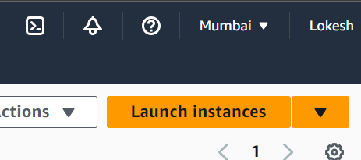
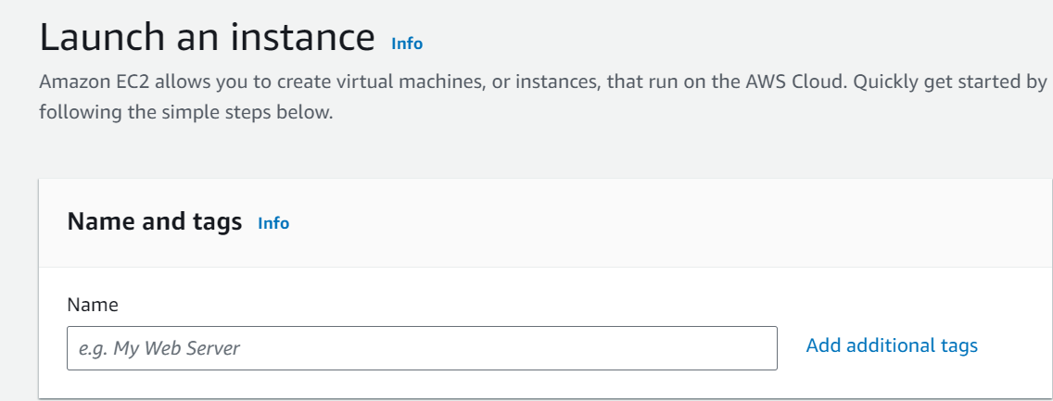
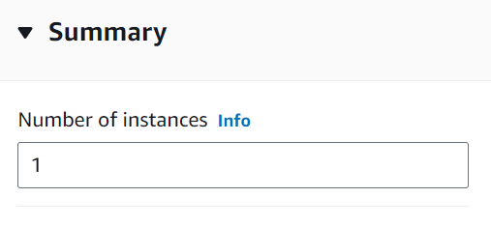
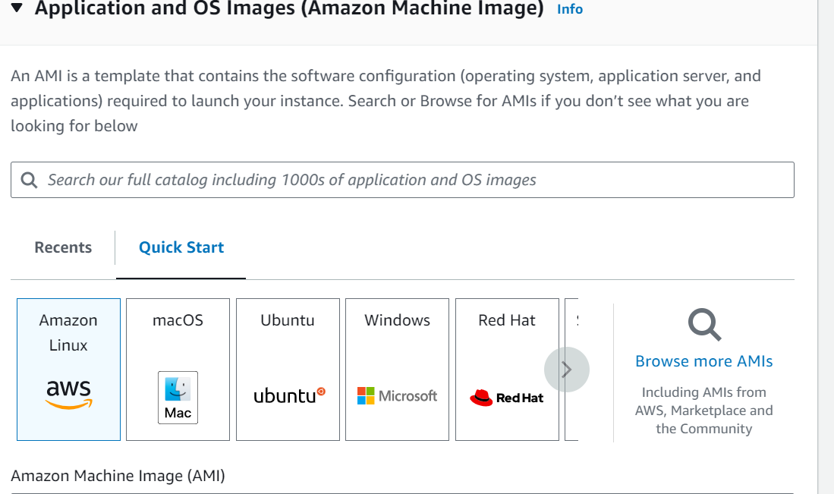
Follow the below instructions and launch an Instance:
Add the tag line and no.of instances:
Select the OS Image:

Slide 13
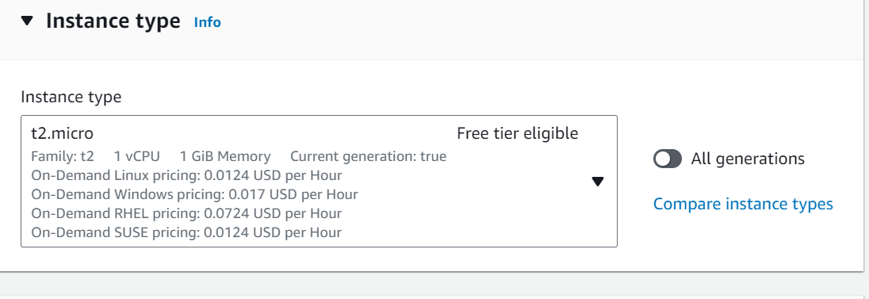
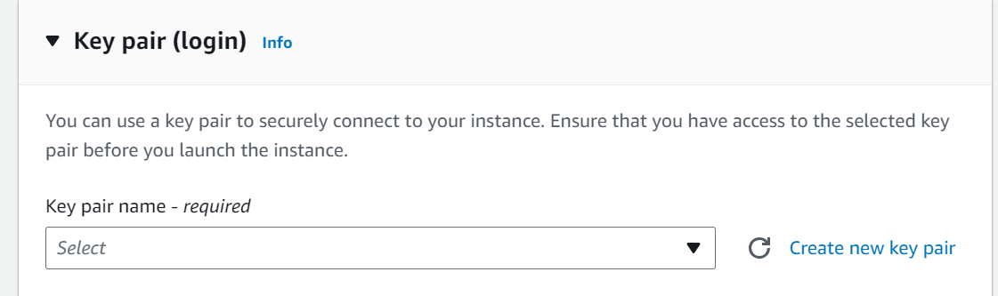
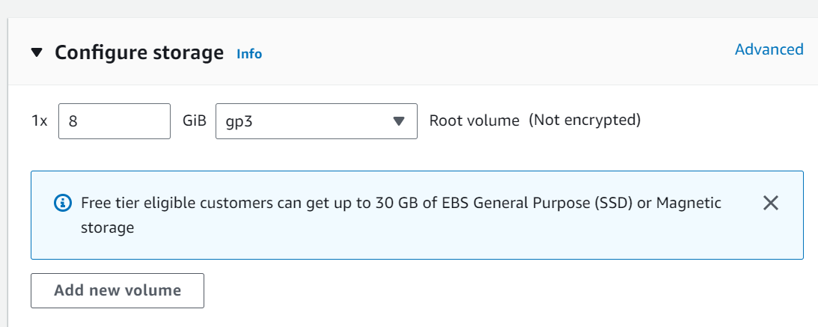
Select the instance type t2.micro for free tier.
Click on create new keypair and generate new one.

Slide 14
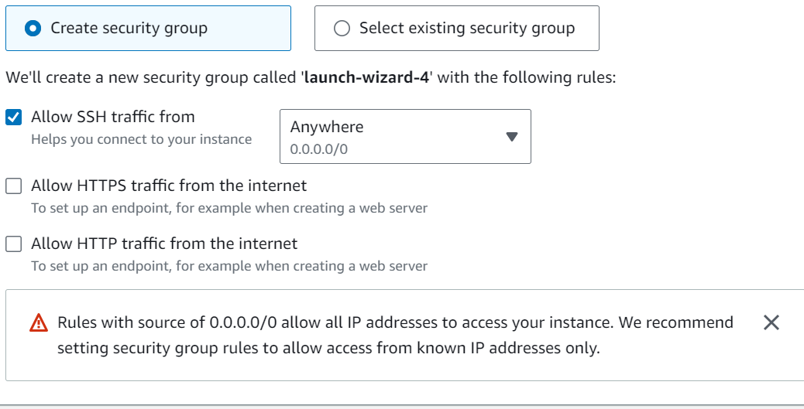
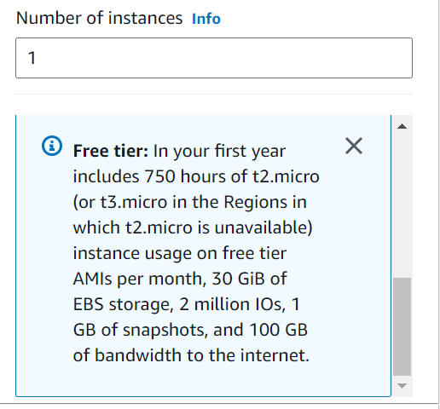
Enable the security groups which are required for your instance.
Please, note below resources are available for t2.micro instance.

Slide 15
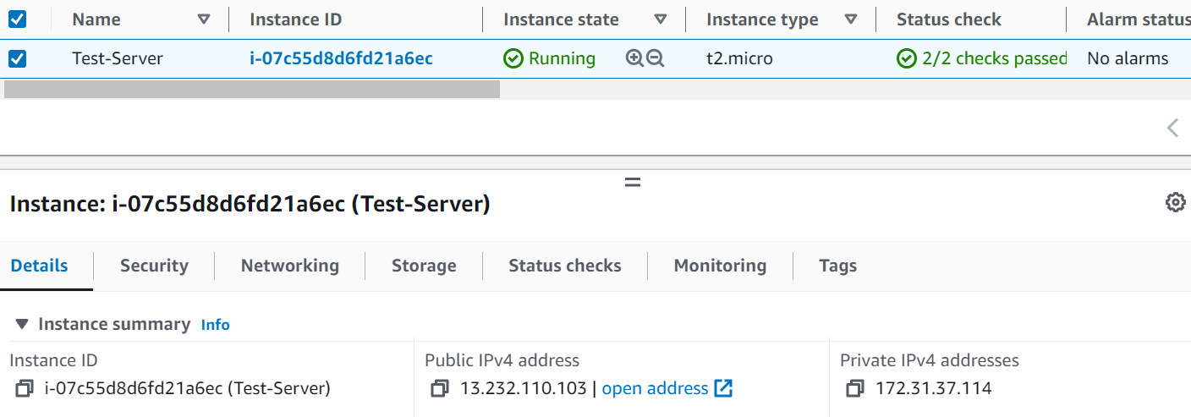
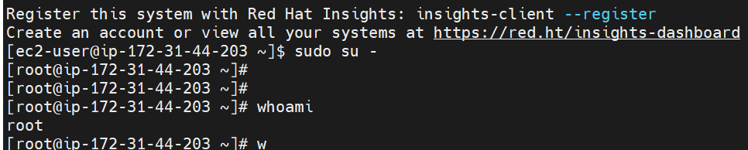
We can connect instance by using Public IP:
Connecting instance by using PPK file (private-Key)

Slide 16
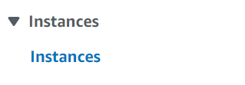
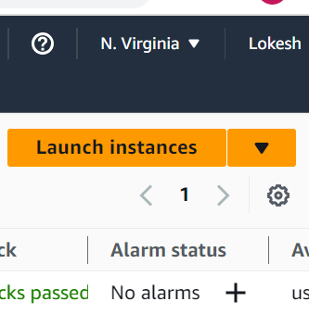
How to Launch Windows server In AWS:
Please follow the below steps:
Click on Launch instance:

Slide 17
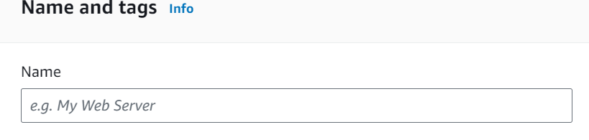
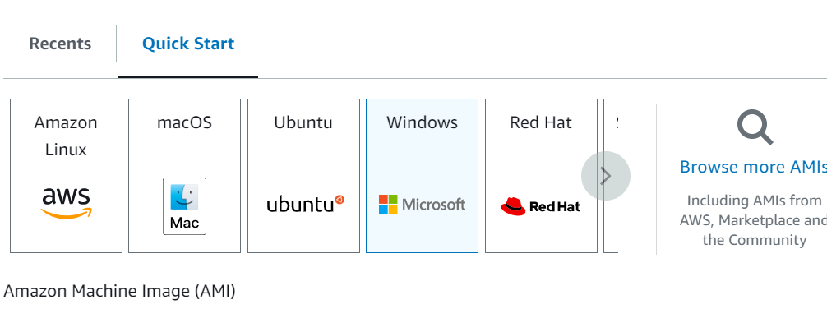
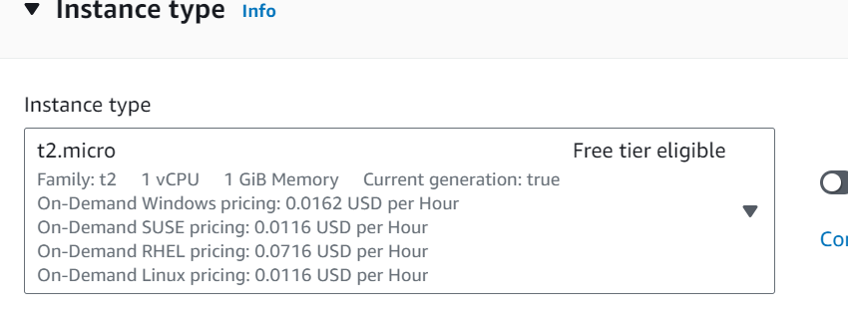
Add The tag Line:
Select the Windows Image:
By Default it will take t2.micro instance type for free tire Account:

Slide 18
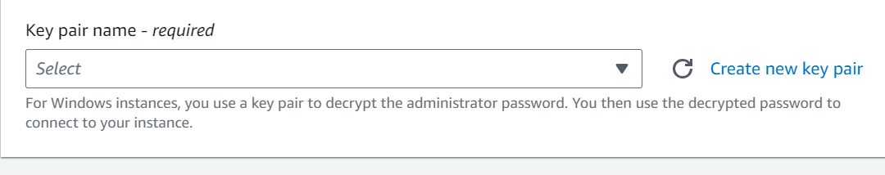
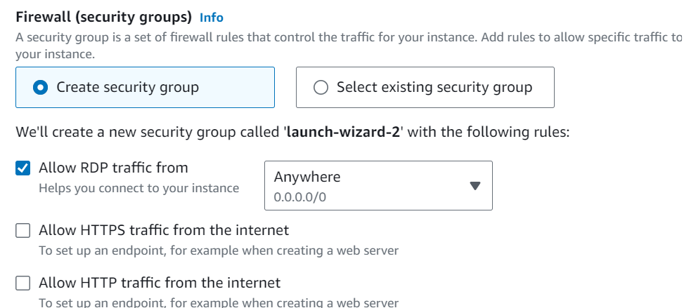
Create a new Keypair to connect Instance:
Enable Security groups Which you needed:

Slide 19
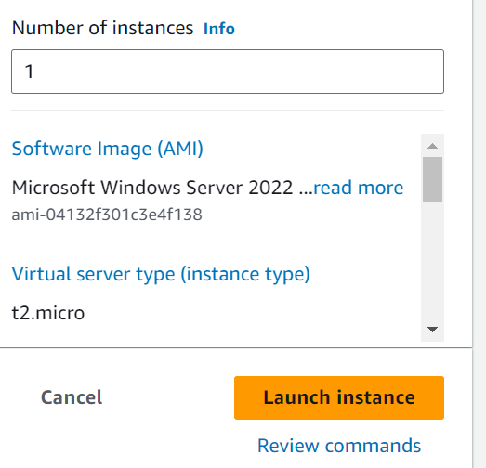
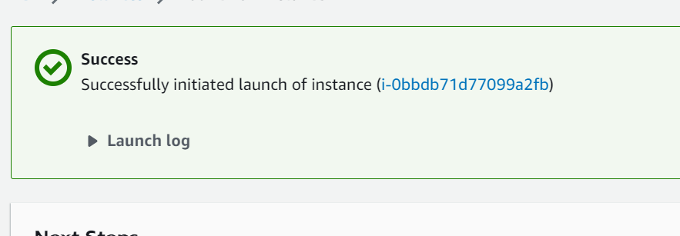
Type the number of instances and click on Launch:

Slide 20
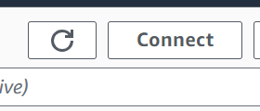
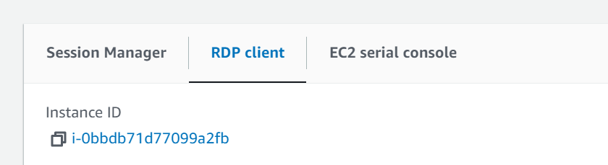
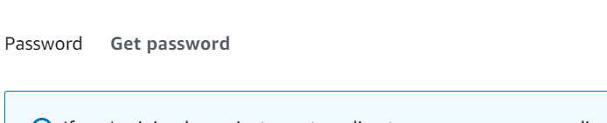
Click on connect button:
Select the RDP Client:
Click on get password:

Slide 21
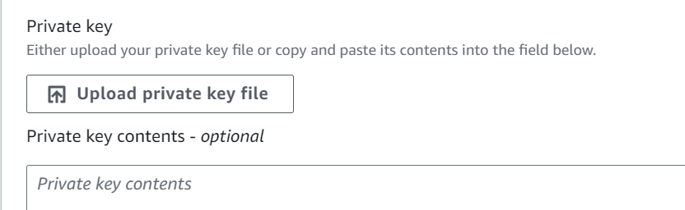
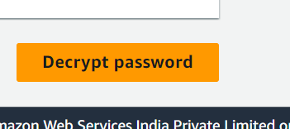
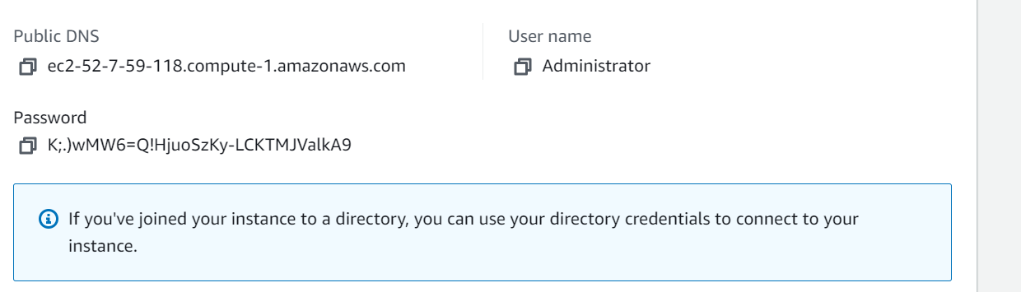
Upload the Private Key-file(Pem)
Click on Decrypt Password
Will get username and password as shown below:

Slide 22
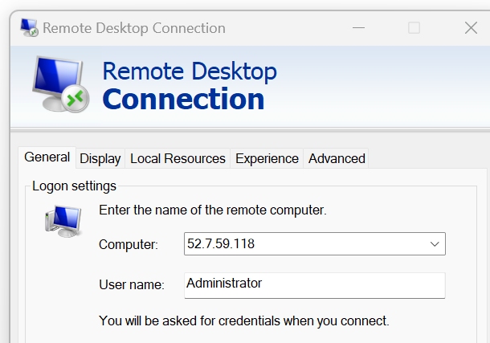
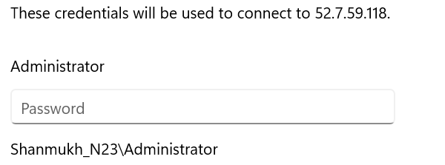
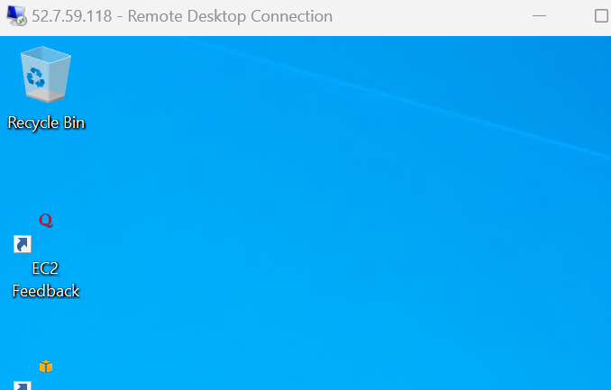
Provide the credentials and connect with server:

Slide 23
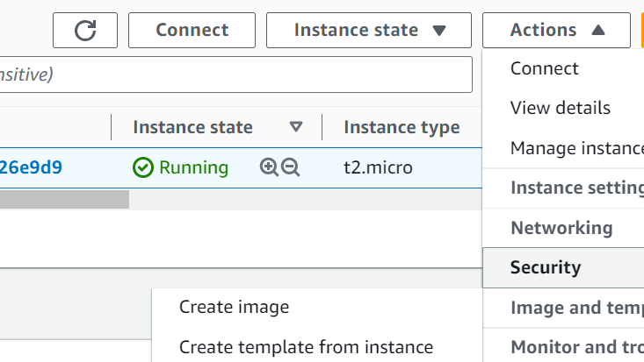
AMI:
An AMI stands for Amazon Machine Images
An AMI is a virtual image used to create a virtual machine within an EC2 instance.
You can also create multiple instances using single AMI when you need instances with the same configuration.
You can also create multiple instances using different AMI when you need instances with a different configuration.
create an instance and follow the below step to create AMI.

Slide 24
AMAZON VPC:
VPC stands for Virtual Private Cloud.
Amazon Virtual Private Cloud (Amazon VPC) provides a logically isolated area of the AWS cloud where you can launch AWS resources in a virtual network that you define
You have complete control over your virtual networking environment, including a selection of your IP address range, the creation of subnets, and configuration of route tables and network gateways.
You can easily customize the network configuration for your Amazon Virtual Private Cloud.
For example, you can create a public-facing subnet for web servers that can access to the internet and can also place your backend system such as databases or application servers to a private-facing subnet.
You can provide multiple layers of security, including security groups and network access control lists, to help control access to Amazon EC2 instances in each subnet.
What can we do with a VPC?
Launch instances in a subnet of your choosing. We can choose our own subnet addressing.
We can assign custom IP address ranges in each subnet.
We can configure route tables between subnets.
We can create an internet gateway and attach it to our VPC.
It provides much better security control over your AWS resources.
We can assign security groups to individual instances.
We also have subnet network access control lists (ACLS).

Slide 25
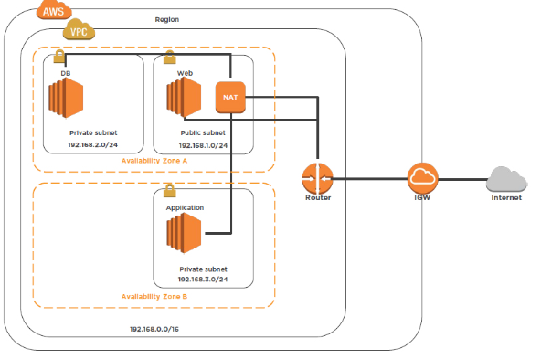
VPC architecture

Slide 26
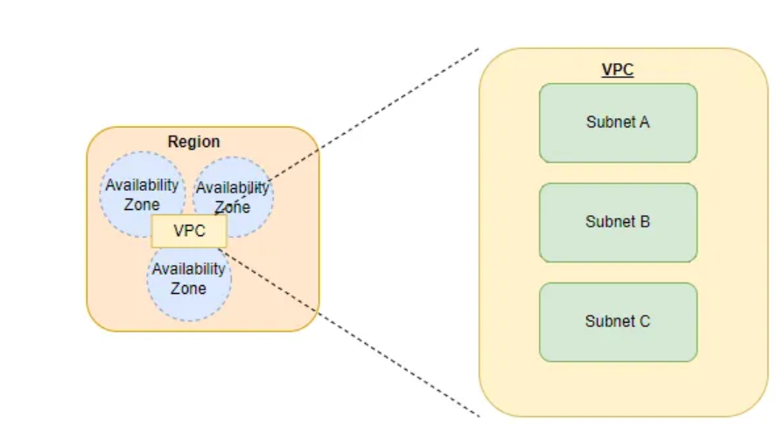
Subnet:
A subnet is essentially a range of IP (v4 and v6) addresses.
We can assign IP addresses to resources within our VPC. These resources can be EC2 instances.
A subnet must live within a single Availability Zone. A region in AWS has multiple availability zones. A VPC spans all availability zones region. An availability zone can have multiple subnets.
Each subnet is assigned a route table. This table is a set of rules that specify the allowed routes for outbound traffic. Each subnet can be assigned with only one route table.

Slide 27
public subnet:
A subnet that can access the Internet is a public subnet.
It is the subnet that has a route table entry that points to an internet gateway. Resources that are required to face or receive Internet traffic can be added to a public subnet.
NOTE: The default VPC contains a public subnet.
private subnet:
A subnet that cannot access the Internet is a private subnet.
It is the subnet that does not have a route table entry that points to an internet gateway. Resources that are not required to be publicly available are within a private subnet.
Subnet Security:
We can create security groups and assign them to a subnet. A security group controls the traffic for the instances within a subnet.
We can also create network ACLs. The ACLs control the traffic for the subnet.
We recommend using both security groups to secure instances and ACLs to secure the subnets.

Slide 28
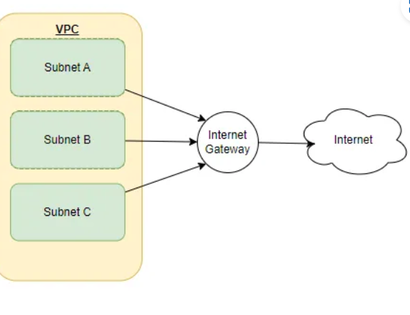
Gateway:
A gateway essentially connects a VPC to another network. For instance, if we want to connect a VPC to the internet then we will use an Internet Gateway. The default VPC includes an internet gateway by default.
The default VPC has a public subnet in each availability zone along with an internet gateway.

Slide 29
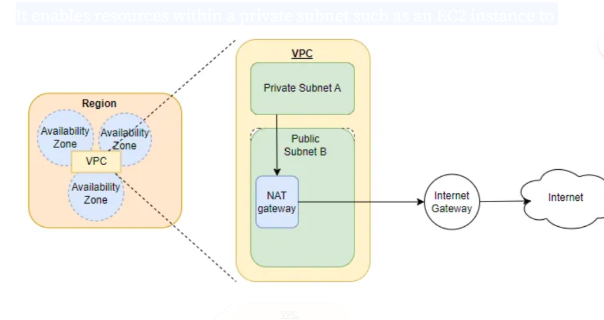
NAT gateway :
A NAT gateway is an AWS-managed service.
It enables resources within a private subnet such as an EC2 instance to access the internet. Hence it allows resources to send outbound traffic to the internet.

Slide 30
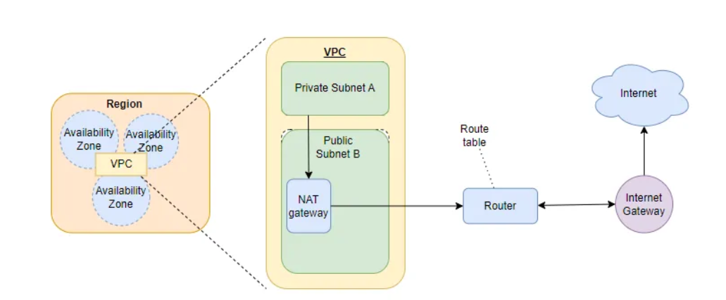
Route Table:
Route tables are essentially a set of rules.
These rules help us determine where to direct the network traffic from a subnet or gateway.
We can assign a specific route table to a subnet.
A route table has a destination that is essentially the range of IP addresses where we want the traffic to go and a target that is the gateway or a network interface or a connection through which to send the traffic.
The route table will specify a range of destinations and target IP addresses.

Slide 31
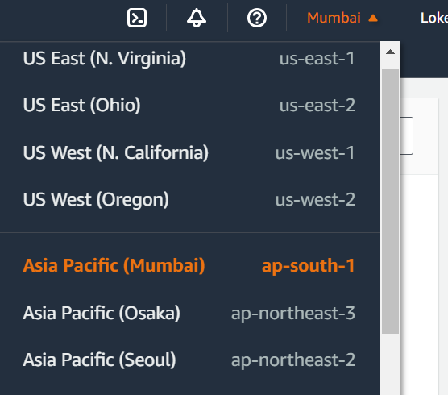
Around the world, the AWS cloud expands across 96 availability zones within 30 geographic regions.
AWS Region:
An AWS Region is a cluster of data centers in a specific geographic area, such as the Northeastern United States or Western Europe. It is a best practice to choose a region that is geographically close to users.
Each AWS Region includes multiple AZs. However, each AZ is restricted to a specific AWS Region. You can use multiple AZs within one Region, but you can't use the same AZ across multiple Regions.
AWS Availability Zone:
An AZ is a standalone data center or set of data centers within a Region.
Each AZ operates independently, so a failure in one won't affect others. In disaster recovery plans, enterprises use multiple AZs to increase redundancy and reliability.

Slide 32
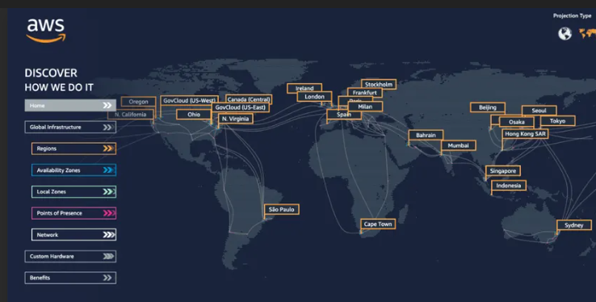
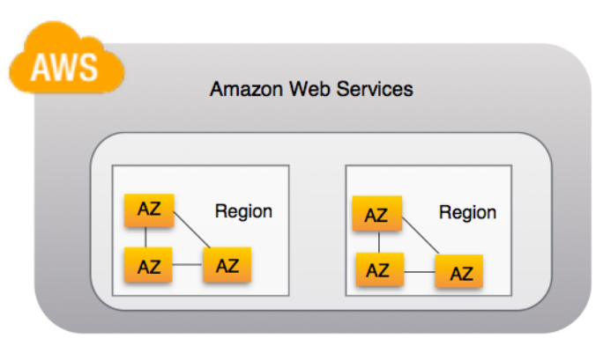
AWS Region Map

Slide 33
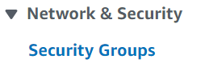
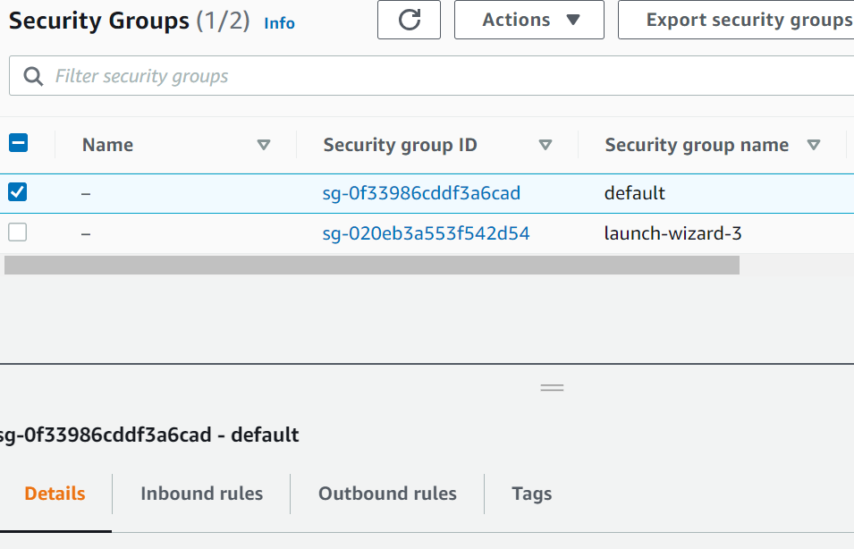
Security Groups:
Essentially, a Security Group is a firewall configuration for your services. It defines what ports on the machine are open to incoming traffic, which directly controls the functionality available from it as well as the security of the machine.
By default, every port is closed. Many firewall systems will have “DENY” rules; AWS instead blocks everything unless there is a rule specifically allowing it to go through. This means that any packet that doesn’t match any rules will be dropped instantly. So, if you want to run a web server on your EC2 or ECS instance, you’ll need to create a security group allowing port 80 and port 443 through the firewall.

Slide 34
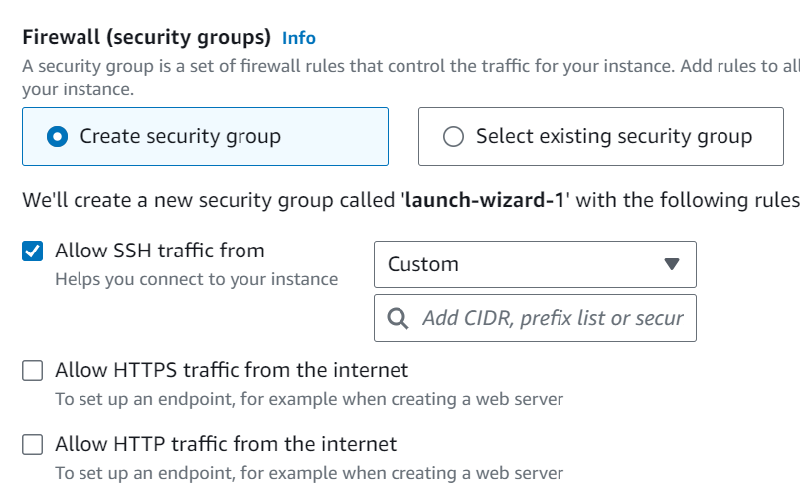
Rules:
1.Inbound
2.Outbound
1.Inbound:
When you create a security group, it has no inbound rules. No inbound traffic originating from another host to your instance is allowed until you add inbound rules to the security group.
The inbound rule in your security group must allow traffic on all ports. It needs to do this because the destination port number of any inbound return packets is set to a randomly allocated port number.

Slide 35
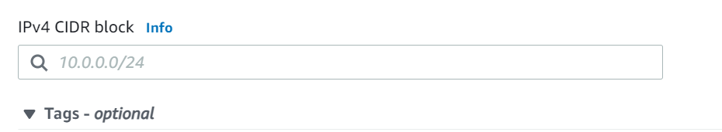
outbound rule:
By default, a security group includes an outbound rule that allows all outbound traffic. We recommend that were move this default rule and add outbound rules that allow specific outbound traffic only.
CIDR:
Classless Inter-Domain Routing (CIDR) is a group of IP addresses that are allocated to the customer when they demand a fixed number of IP addresses.
IPV4 (Internet Protocol Version 4):
It is the first version of Internet Protocol address.
The address size of IPV4 is 32 bit number. In this Internet Protocol Security (IPSec) with respect to network security is optional. It is having 4,294,967,296 number of address still we are seeing a shortage in network addresses as the use of network & virtual devices are increasing rapidly.
EX:192.168.98.1

Slide 36
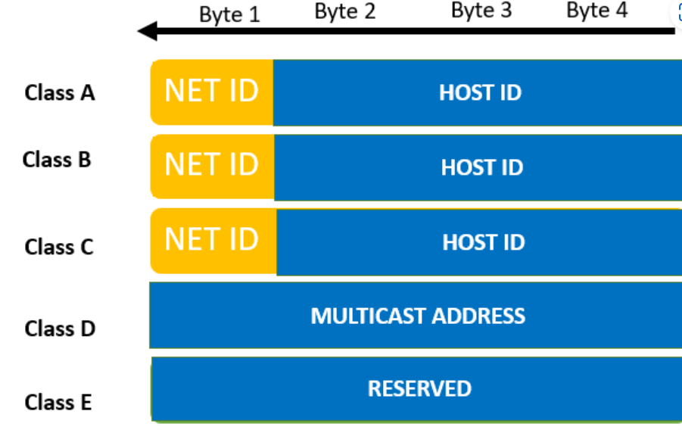
IPV6 (Internet Protocol Version 6):
It is the recent version of Internet Protocol address.
The address size of IPV6 is 128-bit number. In this Internet Protocol Security (IPSec) with respect to network security is mandatory. It allows 3.4 x 10^38 unique IP addresses which seems to be more than sufficient to support trillions of internet devices present now or coming in future.
EX: 2345:0425:2CA1:0000:0000:0567:5673:23b5
IP classes:

Slide 37

Network ID:
It is the part of the left-hand IP address that identifies the specific network where the device is located. In the normal home network, where the device has an IP address 192.168.1.32, the 192.168.1 part of the address will be the network ID. It is customary to fill in the last part that is not zero, so we can say that the device’s network ID is 192.168.1.0.

Slide 38


Hosting ID:
The host ID is part of the IP address that was not taken by the network ID. Identifies a specific device (in the TCP / IP world, we call devices “host”) in that network. Continuing with our example of the IP address 192.168.1.32, the host ID will be 32- the unique host ID on the 192.168.1.0 network.

Slide 39

The Five Ip’s will be reserved in each subnet:

Slide 40



Any octet that's 255 is just 11111111 in binary. This means that 255.255.255.0 is really 11111111.11111111.11111111.00000000 in binary.
Now let's look at a subnet mask and IP address together and calculate which parts of the IP address are the network bits and host bits.
Here are the two in both decimal and binary:
2^(7) 2^(6) 2^(5) 2^(4) 2^(3) 2^(2) 2^(1) 2^(0)

Slide 41



Creating VPC, Subnets, Route tables, Internet gateway:
Select the VPC and click on create VPC to create new VPC:

Slide 42



Fill the VPC name Tag and CIDR range as shown below and click on create VPC:
The VPC will be created with the name tag and VPC-ID

Slide 43




Create Two subnets Public & Private with the Test-VPC :

Slide 44



Click on Create IGW :
IGW will be created :
Create TWO Route tables (PUB&PVT):

Slide 45


Create second subnet (Private subnet):
Two Subnets are created:

Slide 46



Two Route tables are created under Test VPC:

Slide 47


Attach the IGW to Test-VPC as shown below:
After selecting VPC Click on attach IG:
IG Attached to Test-VPC

Slide 48


Click on Edit subnet association tab in PUB-route table and attach the PUB-subnet:
Click on save association:

Slide 49


Click on Edit routes :
Add route to connect IGW:

Slide 50


Click on Edit subnet association tab in PVT-route table and attach the PVT-subnet:

Slide 51



Go to EC2 and Launch two Linux servers in subnets (one is in pub-subnet) another server in (PVT-subnet) and attach the same VPC for two servers which we have created TEST-VPC.
Click on EDIT and select the PUB-subnet for public server.

Slide 52

Launch another Linux server and click on edit in network settings tab and select the PVT-subnet for 2nd server.
NOTE: Select the VPC which we have created TEST-VPC

Slide 53



When we are trying to connect with 1st server (PUB-server) which is under pub-subnet we are able to connect.
When we are trying to connect with 2nd server (PVT-server) which is under PVT-subnet we are not able to connect
We can connect 2nd server from 1st server as shown below but for 2nd server will not get INTERNET access.

Slide 54


Below Image belongs to 1st server which have INTERNET access:
Below Image belongs to 2nd server which don’t have INTERNET access:

Slide 55


Now we will try with the Windows servers. Launch the two WIN servers in subnets (one is in pub-subnet) another server in (PVT-subnet) and attach the same VPC for two servers which we have created TEST-VPC.
Modify the subnets as shown below about two servers:

Slide 56



When we are trying to connect with two WIN servers one server will not connect which is under PVT-subnet as shown below:
The INSTRENET access will be available in one server but not available in another server which is under PVT-subnet as shown below:

Slide 57
NAT Gateway:
NAT Gateway, also known as Network Address Translation Gateway, is used to enable instances present in a private subnet to help connect to the internet or AWS services.
In addition to this, the gateway makes sure that the internet doesn’t initiate a connection with the instances. NAT Gateway service is a fully managed service by Amazon, that doesn’t require any efforts from the administrator.
A NAT gateway in a device forwards the traffic from instances present in the private subnet to the internet/AWS services, and sends back the response from the server back to the instance.
When the traffic moves to the internet, an IPV4 address gets replaced with the NAT’s device address.
Once the response is obtained, it has to be sent to the instance, and in this case, the NAT device translates the address back to the IPV4 and it is given to the IPV4 address.
Elastic IP:
An Elastic IP address is a static, public IPv4 address designed for dynamic cloud computing.
You can associate an Elastic IP address with any instance or network interface in any VPC in your account.
With an Elastic IP address, you can mask the failure of an instance by rapidly remapping the address to another instance in your VPC.
Elastic IP addresses for IPv6 are not supported.

Slide 58


We will Create the NAT gateway and please follow the below steps to create NAT gateway:
Click on create NAT gateway

Slide 59


NAT gateway and Elastic IP will be created as shown below:

Slide 60


Click on Edit routes and add the NAT gateway in PVT route table

Slide 61


Now We can be able to connect the internet which servers are under PVT-subnet:
Linux Server:
Windows Server:

Slide 62

VPC peering:
A VPC peering connection is a networking connection between two VPCs that enables you to route traffic between them using private IPv4 addresses or IPv6 addresses.
Instances in either VPC can communicate with each other as if they are within the same network.
Through VPC Peering, traffic stays within the AWS network and not go over the internet.
Non-overlapping CIDRs – The 2 VPCs you are trying to peer, must have a mutually exclusive set of IP ranges.
Transitive VPC Peering – not allowed.
To understand what is transitive peering, Please refer to the following image.

Slide 63


Click on Create peering connection:
Provide the name and fill the requester VPC id and accepter VPC id as shown in below Images:

Slide 64


Select VPC peering within your ac or another ac and select the Region peering VPC’s are available in same region or different region as shown below:
Click on to create Peering connection:

Slide 65



Peering connection will be created as shown below:

Slide 66


Click on actions accept the peering request.
After accepting the request status will be displayed as below:

Slide 67


Go to route tables which are associated with VPC’s and add the VPC CIDR range in route table as shown below:

Slide 68


Go to route tables which are associated with VPC’s and add the VPC CIDR range in route table as shown below:

Slide 69


Below two servers are from two different VPC’s and we will try to connect the first server and from 1st server try to connect 2nd server as shown below:
We have successfully connected the servers which are from two different VPC’s within same region.

Slide 70

S3:
S3 stands for Simple Storage Service.
It is easy to use with a simple web services interface to store and retrieve any amount of data from anywhere on the web.
S3 is a safe place to store the files.
It is Object-based storage, i.e., you can store the images, word files, pdf files, etc.
The files which are stored in S3 can be from 0 Bytes to 5 TB.
S3 is a universal namespace, i.e., the names must be unique globally. Bucket contains a DNS address. Therefore, the bucket must contain a unique name to generate a unique DNS address.

Slide 71
Create Buckets:
Firstly, we create a bucket and provide a name to the bucket. Buckets are the containers in S3 that stores the data. Buckets must have a unique name to generate a unique DNS address.
Storing data in buckets:
Bucket can be used to store an infinite amount of data. You can upload the files as much you want into an Amazon S3 bucket, i.e., there is no maximum limit to store the files. Each object can contain up to 5 TB of data. Each object can be stored and retrieved by using a unique developer assigned-key.
Download data:
You can also download your data from a bucket and can also give permission to others to download the same data. You can download the data at any time whenever you want.
Permissions:
You can also grant or deny access to others who want to download or upload the data from your Amazon S3 bucket. Authentication mechanism keeps the data secure from unauthorized access.
Standard interfaces:
S3 is used with the standard interfaces REST and SOAP interfaces which are designed in such a way that they can work with any development toolkit.

Slide 72


Security:
Amazon S3 offers security features by protecting unauthorized users from accessing your data.
How to Create S3 bucket in AWS console:

Slide 73


Enable the bucket versioning and create the bucket.

Slide 74


Click on add files or folder to add files & folders
After adding click on upload button.

Slide 75


How to provide Public access to Bucket.
Uncheck the block all public access as shown below.

Slide 76



Click on ACL enabled.
Click on actions and make public using ACL and Use the object URL to download the files in bucket.

Slide 77


How to create S3 bucket through CLI:
Create IAM user with secret-Key and access-Key as shown below:
Click on add user to add the user

Slide 78



Provide the username Click on next
Click on custom password to create custom password for IAM user

Slide 79


Click on attach policies directly
Search for S3 full access and select the policy to attach IAM user

Slide 80



Finally click on create the user to create user
After creating IAM user Please generate access key and security key to create S3 bucket through CLI
Click on create Access Key it will generates both access & secret key.
After creating copy and save access & secret key.

Slide 81


Use the below link to install or update the latest release of the AWS Command Line Interface (AWS CLI) on supported operating-systems.
https://docs.aws.amazon.com/cli/latest/userguide/getting-started-install.html
After Installing AWS CLI latest version use below command to check latest version in windows CLI prompt.
aws s3 --version

Slide 82


Use below command to configure access and secret Key as shown below
aws configure
Use below command to create S3 bucket
aws s3 mb s3://bucketname ------ to create bucket
aws s3 ls ----to list the buckets

Slide 83

Copying files from local (windows) to S3 bucket using CLI
aws s3 cp filename s3://bucketname
After copying files in to bucket

Slide 84


To list the files in Bucket
Removing Bucket using CLI
aws s3 rb s3://bucketname

Slide 85

Creating S3 buckets using CLI from Linux server
Configure secret and access key by using command -- aws configure
aws s3 –version == To check AWS cli version

Slide 86


Create S3 bucket by using below command
aws s3 mb s3://bucketname
List the files in bucket by using aws s3 ls
Copying files from Server to S3 bucket by using below command
aws s3 cp filename s3://bucketname

Slide 87

Deleting entire bucket with files
Aws s3 rb s3://bucketname --force

